Slide 1
Cloud Computing
SEWP ZG527

Slide 2
8
What is MapReduce?

Slide 3

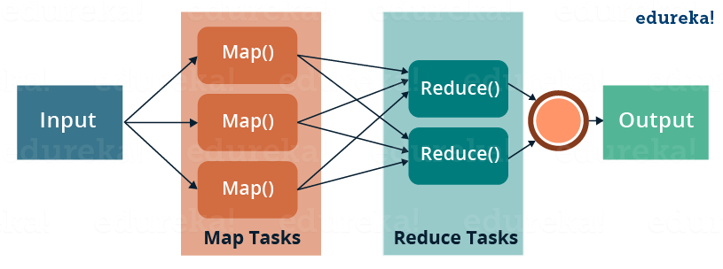
What is MapReduce?
MapReduce is a programming framework that allows us to perform distributed and parallel processing on large data sets in a distributed environment

Slide 4
What is MapReduce?
MapReduce is a programming framework that allows us to perform distributed and parallel processing on large data sets in a distributed environment

Slide 5
9
MapReduce Word Count Program

Slide 6
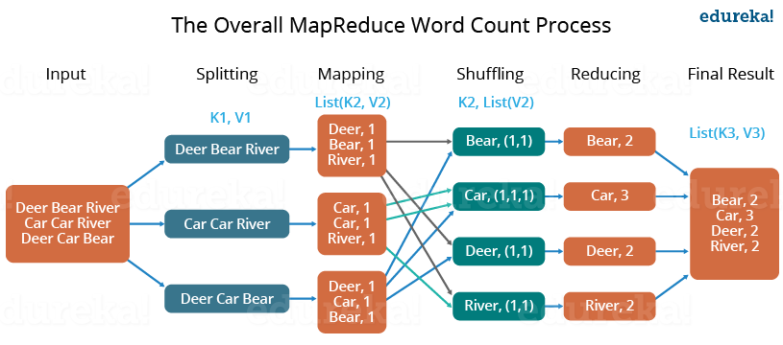
MapReduce Word Count Program

Slide 7
MapReduce Word Count Program
Three Major Parts of MapReduce Program:
1
Mapper Code:
You write the mapper logic over here i.e. how map task will process
the data to produce the key-value pair to be aggregated
2
Reducer Code:
You write reducer logic here which combines the intermediate key-value
pair generated by Mapper to give the final aggregated output
Driver Code
You specify all the job configurations over here like job name,
Input path, output path, etc.
3

Slide 8
10
MapReduce Job Workflow

Slide 9
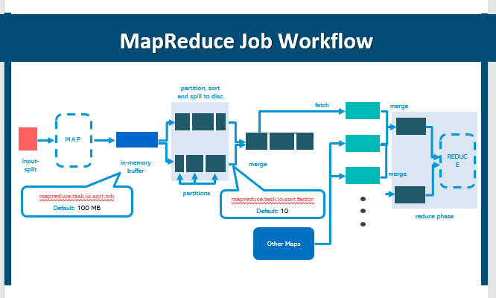

Slide 10
11
MapReduce Word Count Program

Slide 11
MapReduce Word Count Program

Slide 12
MapReduce Word Count Program
Three Major Parts of MapReduce Program:
1
Mapper Code:
You write the mapper logic over here i.e. how map task will process
the data to produce the key-value pair to be aggregated
2
Reducer Code:
You write reducer logic here which combines the intermediate key-value
pair generated by Mapper to give the final aggregated output
Driver Code
You specify all the job configurations over here like job name,
Input path, output path, etc.
3

Slide 13
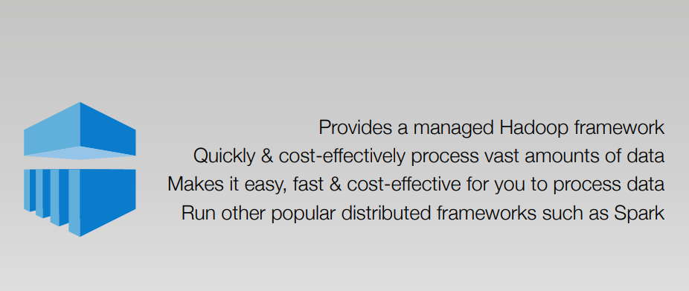
AWS Elastic Map Reduce

Slide 14
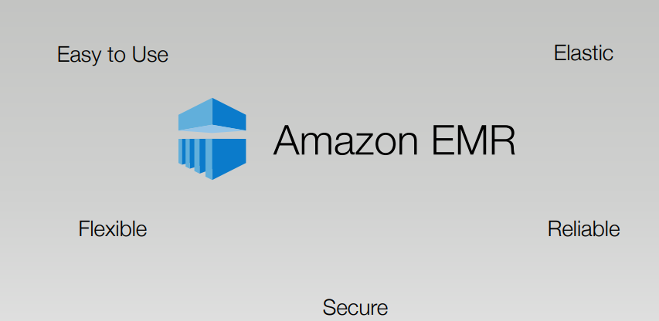
Low Cost

Slide 15
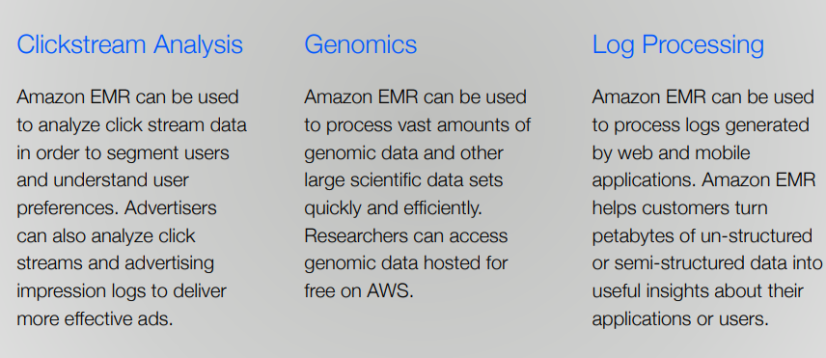
AWS EMR Use Cases

Slide 16
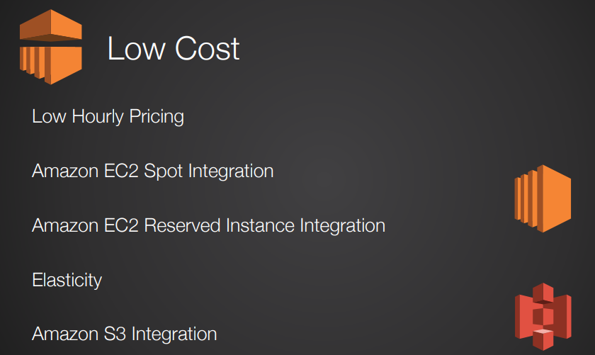
Core Characteristics of EMR

Slide 17
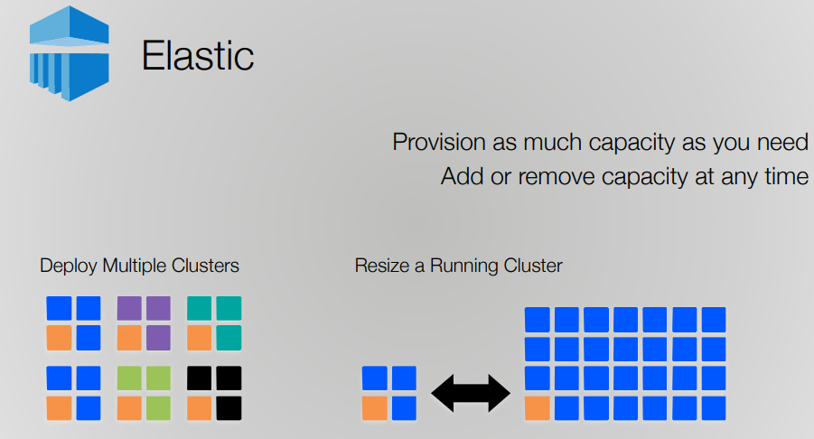
Core Characteristics of EMR

Slide 18
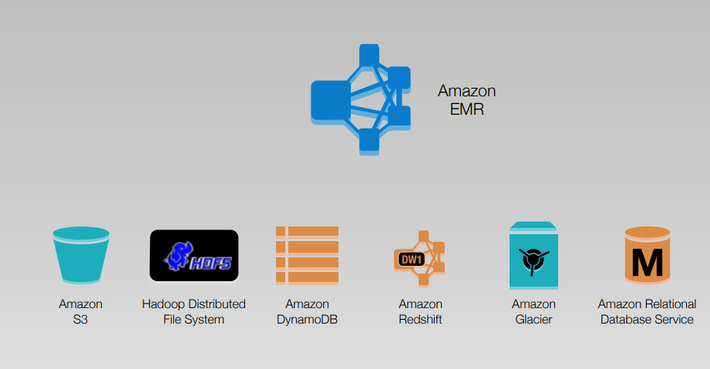
EMR Data Stores

Slide 19
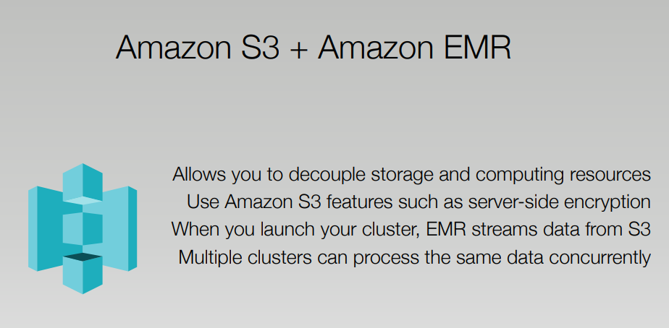
EMR and S3

Slide 20
What is Amazon S3? Elaborate.
S3 (Simple Storage Service) provides scalable object storage space to firms and IT professionals. It is one of the earliest services introduced by AWS. The easy-to-use web services interface of S3 allows users to store and retrieve data from remote locations. S3 contains buckets to store files/data.
Users create a bucket in the S3 and name it as if it is a universal namespace. An HTTP 200 code is received on successful uploading of a file to the assigned S3 bucket. A unique name is given to each bucket to generate the DNS address (unique).
There are four types of pricing models for Amazon EC2 instances that are as follows:
On-demand instance – On-demand pricing or pay-as-you-go model allows you to pay only for the resources used till now. Depending on the instances, you will have to pay by second/hour for the resources. The on-demand pricing model is good if the work hours are short and unpredictable as they do not require any upfront payment.
Reserved instance – It is the best model to use if you have a prerequisite for your upcoming requirements. Firms calculate their future EC2 requirements and pay upfront to get a discount of up to 75%. Reserved instances will save computing capacity for you, and you can use them wherever required.
Spot Instance – If some extra amount of computing capacity is required immediately, one can opt for spot instances at up to a 90% discount. The unused computing capacity is sold at a heavily discounted rate via the spot instance pricing model.
Dedicated hosts – A customer can reserve a physical EC2 server by opting for the dedicated hosts pricing model.

Slide 21
What are the characteristics of cloud architecture that separates it from the traditional one?
The characteristics that make cloud architecture above traditional architecture is
According to the demand, cloud architecture provides the hardware requirement
Cloud architecture is capable of scaling the resource on demand
Cloud architecture is capable of managing and handling dynamic workloads without failure
What are the different types of virtualization in AWS, and what are the differences between them?
The three major types of virtualization in AWS are:
Hardware Virtual Machine (HVM)
It is a fully virtualized hardware, where all the virtual machines act separate from each other. These virtual machines boot by executing a master boot record in the root block device of your image.
Paravirtualization (PV)
Paravirtualization-GRUB is the bootloader that boots the PV AMIs. The PV-GRUB chain loads the kernel specified in the menu.
Paravirtualization on HVM
PV on HVM helps operating systems take advantage of storage and network I/O available through the host.

Slide 22
Question Cloud interoperability and its use case
What are the main drawbacks of Docker?
Some notable drawbacks of Docker are:
Doesn’t provide a storage option
Offer a poor monitoring option.
No automatic rescheduling of inactive Nodes
Complicated automatic horizontal scaling set up
What are the common instruction in Dockerfile?
The common instruction in Dockerfile are: FROM, LABEL, RUN, and CMD
What are Docker Namespaces?
The Namespace in Docker is a technique which offers isolated workspaces called the Container. Namespaces also offer a layer of isolation for the Docker containers.
Explain in detail single and multi tenant architecture
What are different layers in iaaS, paas and SaaS model

Slide 23
State the limitations of virtualization.
1. If the CPU does not allow for hardware virtualization we can run some operating system in software virtualization but it is generally slower. Some operating system will not run in software virtualization and require to have CPU with hardware virtualization so it would cost more if CPU with hardware virtualization is not possible.
2. Some of the limitations are in analysis and planning which problems can be divided into three types they are
a. It has a high risk in physical fault.
b. It is more complicated to set up and manage virtual environment with high critical servers in a production environment. It is not easy as managing physical servers.
3. It does not support all applications.
discuss the design considerations for storage network.
The best storage area network design for a customer will take into consideration a number of critical issues:
• Uptime and availability
• Capacity and scalability
• Security
• Replication and disaster recovery

Slide 24
Give the best example of open source Cloud Computing.
Open–source cloud is a cloud service or solution built using open–source software and technologies. This includes any public, private or hybrid cloud model providing SaaS, IaaS, PaaS, or XaaS built and operated entirely on open–source technologies. The best example of open source Cloud Computing is OpenStack and Nebula.
This is one of the most frequently asked cloud computing interview questions.
Cloud computing lets us store and access our applications or data over remote computers instead of our computer. First of all, the cloud is just a metaphor for technology. Cloud data centers might be anywhere globally; we can also access them from anywhere with an Internet-connected device. It has the following benefits as given below:
Pay-per-use model: We only have to pay for the services we use.
24/7 Availability: It is always online! There is no such time when you simply cannot use our cloud service; you’ll use it whenever you want.
Easily Scalable: it’s effortless to proportion and down or turn off as per customers’ needs. For instance, if your website’s traffic increases only on Friday nights, you can opt for scaling up your servers that particular day and then scaling down for the rest of the week.
Security: Cloud computing offers excellent data security. Especially if the data is mission-critical, then that data can be wiped off from local drives and kept on the cloud only for your access to stop it from ending up in the wrong hands.
Easily Manageable: You only have to pay subscription fees; the Cloud Provider entirely maintains all maintenance, up-gradation, and delivery of services. This is backed by the Service-level Agreement (SLA).

Slide 25
Name some of the AWS services that are not region-specific
AWS services that are not region-specific are:
IAM
Route 53
Web Application Firewall
CloudFront.
Name advantages and disadvantages of using serverless components in cloud computing.
Your applicants may mention some of the disadvantages listed below when responding to this question:
The components are not always suitable for high-performance computing
The components may be more vulnerable to security issues
The components may make debugging a challenge

Slide 26
Explain briefly about virtual threats.
Some threats to virtualized systems are general in nature, as they are inherent threats to all computerized systems (such as denial-of-service, or DoS, attacks). Other threats and vulnerabilities, however, are unique to virtual machines. Many VM vulnerabilities stem from the fact that vulnerability in one VM system can be exploited to attack other VM systems or the host systems, as multiple virtual machines share the same physical hardware.
Some of the vulnerabilities exposed to any malicious-minded individuals regarding security in virtual environments:
Shared clipboard — Shared clipboard technology allows data to be transferred between VMs and the host, providing a means of moving data between malicious programs in VMs of different security realms.
Keystroke logging — Some VM technologies enable the logging of keystr okes and screen updates to be passed across virtual terminals in the virtual machine, writing to host files and permitting the monitoring of encrypted terminal connections inside the VM.
VM monitoring from the host — because all network packets coming from or going to a VM pass through the host, the host may be able to affect the VM by the following:
1. Starting, stopping, pausing, and restart VMs.
2. Monitoring and configuring resources available to the VMs, including CPU, memory, disk, and network usage of VMs.
3. Adjusting the number of CPUs, amount of memory, amount and number of virtual disks and number of virtual network interfaces available to a VM.
4. Monitoring the applications running inside the VM.
5. Viewing, copying, and modifying data stored on the VM’s virtual disks.
Virtual machine monitoring from another VM — Usually, VMs should not be able to directly access one another’s virtual disks on the host.
Virtual machine backdoors — a backdoor, covert communications channel between the guest and host could allow intruders to perform potentially dangerous operations.

Slide 27
Mention some optimization strategies in the cloud.
Identify resources that are not in use.
Merge all idle resources.
Right-size your computing resources.
Choose the appropriate storage types.
Invest in reserved instances for long term cloud resources usage.
Leverage spot instances for short term cloud usage.
Delete unused elastic block store(EBS) snapshots

Slide 28
Can NameNode and DataNode be a commodity hardware?
The smart answer to this question would be, DataNodes are commodity hardware like personal computers and laptops as it stores data and are required in a large number. But from your experience, you can tell that, NameNode is the master node and it stores metadata about all the blocks stored in HDFS. It requires high memory (RAM) space, so NameNode needs to be a high-end machine with good memory space.
Why do we use HDFS for applications having large data sets and not when there are a lot of small files?
HDFS is more suitable for large amounts of data sets in a single file as compared to small amount of data spread across multiple files. As you know, the NameNode stores the metadata information regarding the file system in the RAM. Therefore, the amount of memory produces a limit to the number of files in my HDFS file system. In other words, too many files will lead to the generation of too much metadata. And, storing these metadata in the RAM will become a challenge. As a thumb rule, metadata for a file, block or directory takes 150 bytes.
.

Slide 29
The role of cloud computing in social networking has many dimensions.
– Cloud computing vendors such as Amazon and Salesforce nowadays provide various services, including Enterprise Resource Planning (ERP) and Customer Relationship Management (CRM). These services are delivered through cloud servers. Hence, clients can use the system’s scalability and flexibility, whereas they don’t need to purchase standalone hardware or software.
Big data analysis for social sites is another face of utilizing cloud computing besides data storage. Business users can get more improved analytics through this.
– From a disaster recovery perspective, the cloud is a safer data storage option. Social networks can do data backup and data recovery at a reduced cost in the cloud. Additionally, data stored at a particular location is riskier than saving it to the cloud. When your data is in the cloud, there are no hardships encountered during recovery. Also, social network users can access shared resources from anywhere using cloud computing. No doubt, this is a beneficial option for most social networks as they hold personal information of its clients
.

Slide 30
Q How is Docker different from Hypervisor?
Q. Write the name of top ten obstacles and opportunities for adoption and growth of cloud computing?
Q What is the difference between traditional data centers and the cloud?
Q . Name some of the AWS services that are not region-specific
Q What are the characteristics of Big Data?
Q Suppose Hadoop spawned 100 tasks for a job and one of the task failed. What will Hadoop do? Explain in detail
Q . Can NameNode and DataNode be a commodity hardware?
Q . What is cloud interoperability and Categories of Cloud Computing Interoperability and portability (marks 6)
Q . What are active and passive “NameNodes”?
Q What are the main drawbacks of Docker?
Q What is rack algorithm in hadoop
Q . Describe the cloud capacity management challenges

Slide 31
Q. What are the key enabling technologies in cloud computing?
Q . Define and explain the three basic types of cloud services and the AWS products that are built based on them?
Q . What are the layers of IaaS Architecture?
Q What are Problems with small files and HDFS?
Q. What are the common instruction in Dockerfile?
Q. Write a Docker file to create and copy a directory and built it using Tomcat server?
Q. What are Docker Namespaces?
Q . What is the need for cloud capacity management?

Slide 32

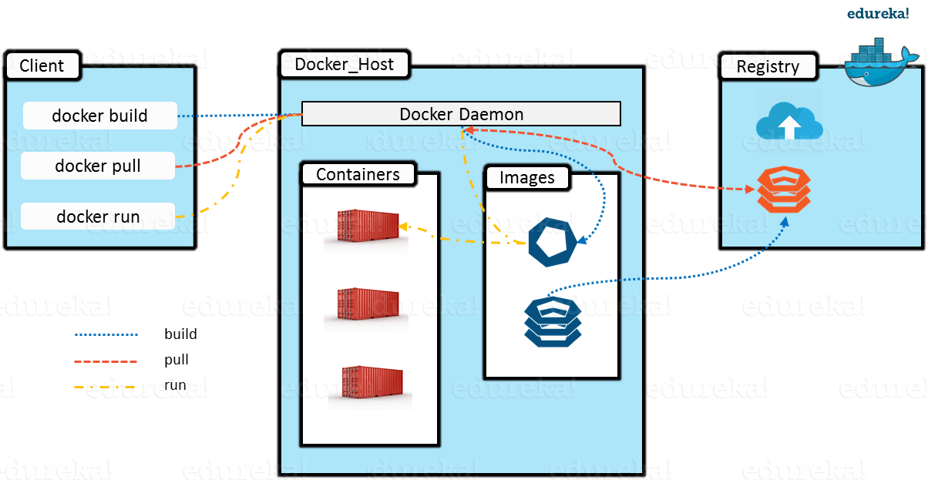
What is Docker Architecture?
Docker Architecture includes a Docker client – used to trigger Docker commands, a Docker Host –
running the Docker Daemon and a Docker Registry – storing Docker Images. The Docker Daemon running within
ocker Host is responsible for the images and containers.
To build a Docker Image, we can use the CLI (client) to issue a build command to the Docker Daemon (running on Docker_Host).
The Daemon will then build an image based on our inputs and save it in the Registry, which can be either Docker hub or a local repository
If we do not want to create an image, then we can just pull an image from the Docker hub, which would have been built by a different user
Finally, if we have to create a running instance of my Docker image, we can issue a run command from the CLI, which will create a Container.

Slide 33
What is the difference between traditional data centers and the cloud?
Traditional Data Center | Cloud Data Center
Physically present, on-premise, and tangible and accessible. | Remotely located, off-premise and intangible.
Businesses pay capital expenditures for the acquisition of hardware and software resources and operational expenditures like those for usage, maintenance, and repair of resources. | Businesses pay only the operational cost for using the resources being used.
Management and administration of the resources are the responsibility of personnel within the business. | Management and administrative responsibilities are the responsibilities of the cloud providers.
Multiple challenges to scaling, like availability of resources and latency in the acquisition process due to the procedures involved | Completely and almost instantly scalable as per requirements.
Failure may lead to loss of business as the responsibility of downtime and repair of services is entirely on the business, affecting the reliability of services. | A cloud service provider is responsible and trusted to replace the resources due to its promise of reliability and availability.

Slide 34
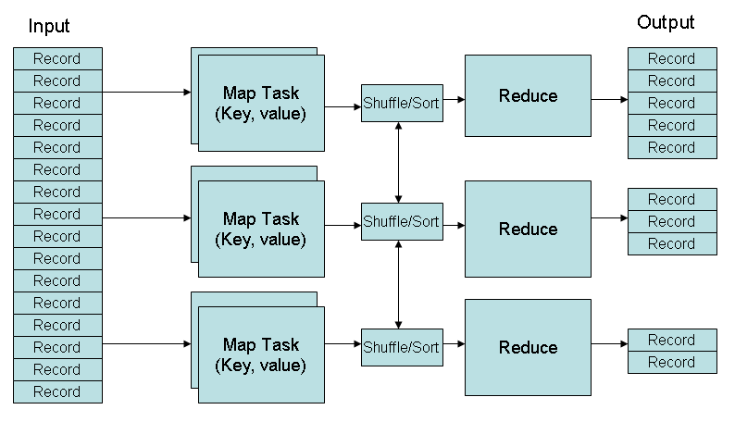
MapReduce Phases

Slide 35


Need an Effective Solution
Scenario:
Multiple Cook cooking food
Issue:
Food Shelf becomes the BOTTLENECK
Food Shelf
(Data)

Slide 36




Need an Effective Solution
Scenario:
Multiple Processing Unit for data processing
Issue:
Bringing data to processing generated lots of Network overhead
Data Warehouse

Slide 37
Issue 2: Food Shelf becomes the Bottleneck
Solution: Distributed and Parallel Approach

Slide 38
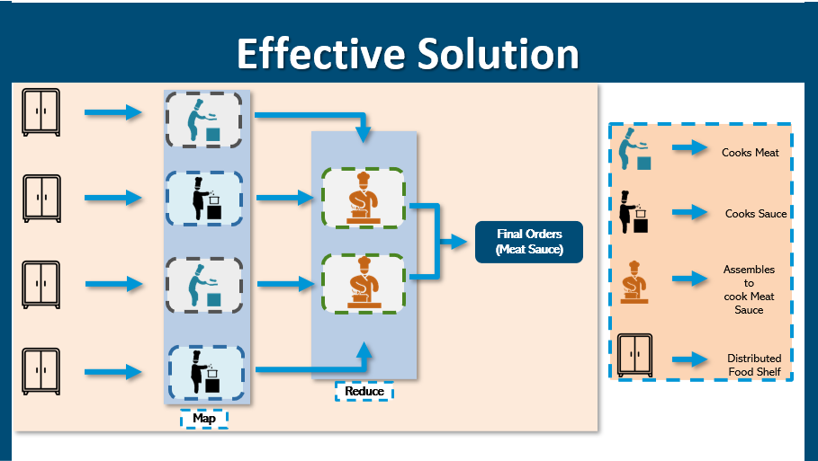

Slide 39

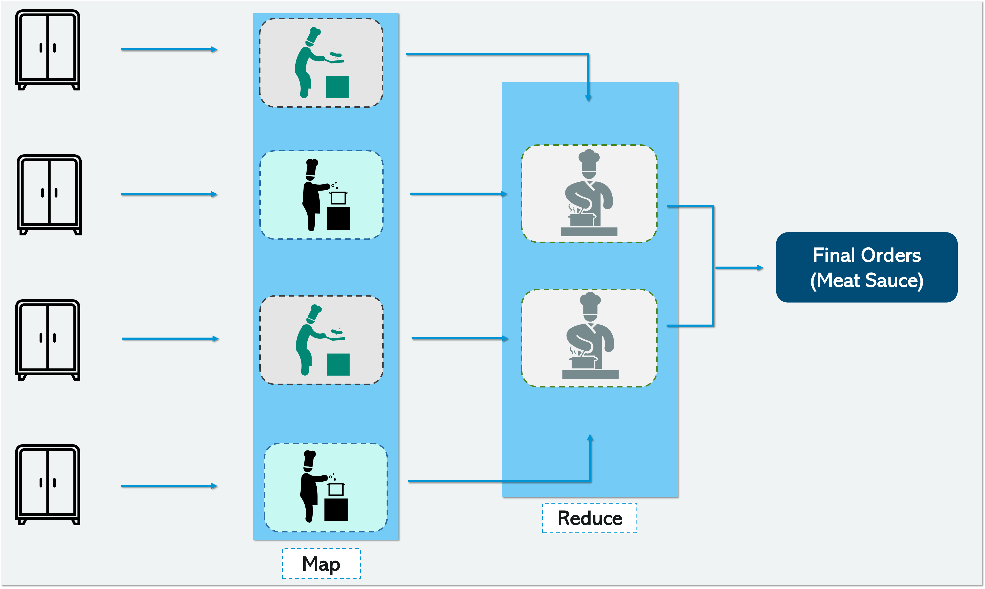

Need a Framework
Do we have a framework that works like that ?

Slide 40
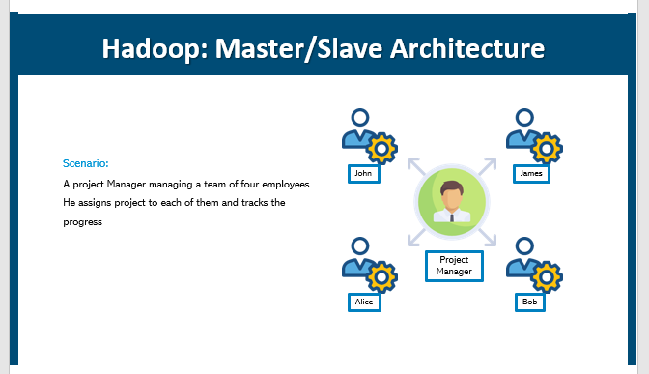

Slide 41
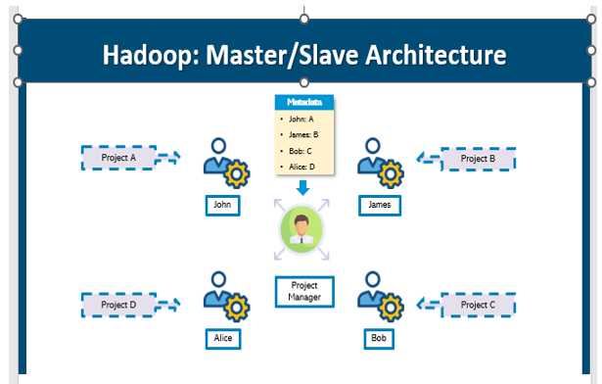

Slide 42
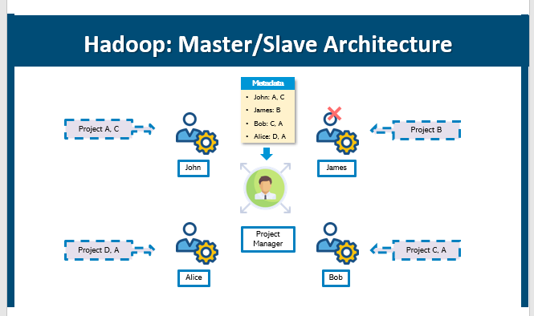

Slide 43
Let us understand Problems with Big Data and Traditional System with a Story

Slide 44
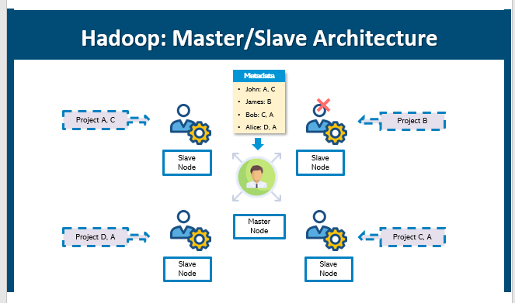

Slide 45
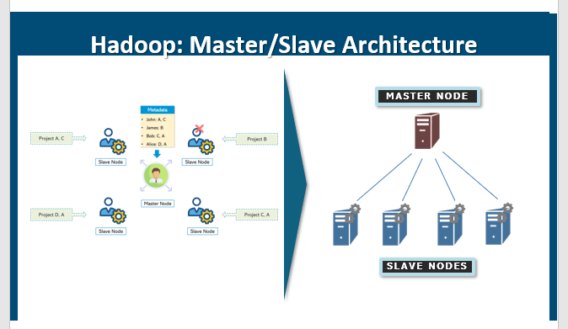

Slide 46
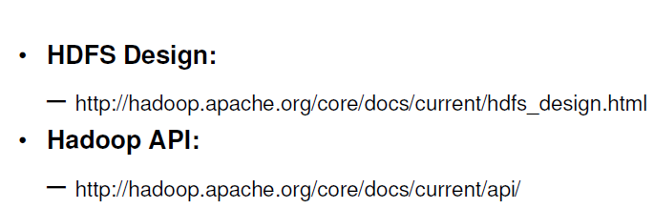
Useful Links

Slide 47
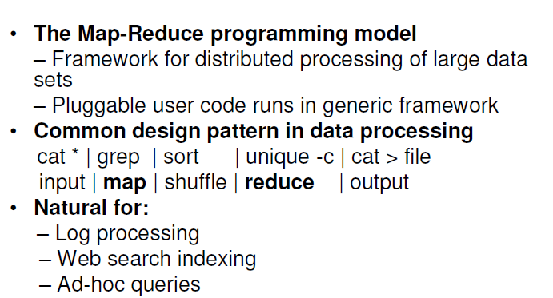
Hadoop Map/Reduce

Slide 48
About Key-Value Pairs
Developer provides Mapper and Reducer functions
Developer decides what is key and what is value
Developer must follow the key-value pair interface
Mappers:
Consume <key, value> pairs
Produce <key, value> pairs
Shuffling and Sorting:
Groups all similar keys from all mappers,
sorts and passes them to a certain reducer
in the form of <key, <list of values>>
Reducers:
Consume <key, <list of values>>
Produce <key, value>

Slide 49
9
What is MapReduce?

Slide 50
What is MapReduce?
MapReduce is a programming framework that allows us to perform distributed and parallel processing on large data sets in a distributed environment

Slide 51
12
Hadoop Cluster

Slide 52
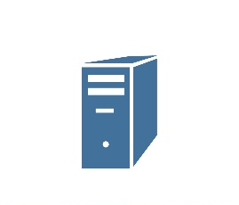
Hadoop Cluster
core switch
switch
switch
switch
NameNode
Slave Nodes
Slave Nodes
Secondary
NameNode
Slave Nodes
Slave Nodes
Slave Nodes
Slave Nodes
Slave Nodes
Slaves and Master Machines
Slave Nodes
Slave Nodes
Slave Nodes
Rack 1
Rack 2
Rack 3

Slide 53
Hadoop Cluster Nodes

Slide 54
Standalone (or Local) Mode
No daemons, everything runs in a single JVM
Suitable for running MapReduce programs during development
Has no DFS or Distributed File System
Hadoop Cluster Nodes
Pseudo Distributed Mode
All Hadoop daemons run on the local machine
Multi-Node Cluster Mode
Hadoop daemons run on a cluster of machines

Slide 55
13
Hadoop Ecosystem

Slide 56
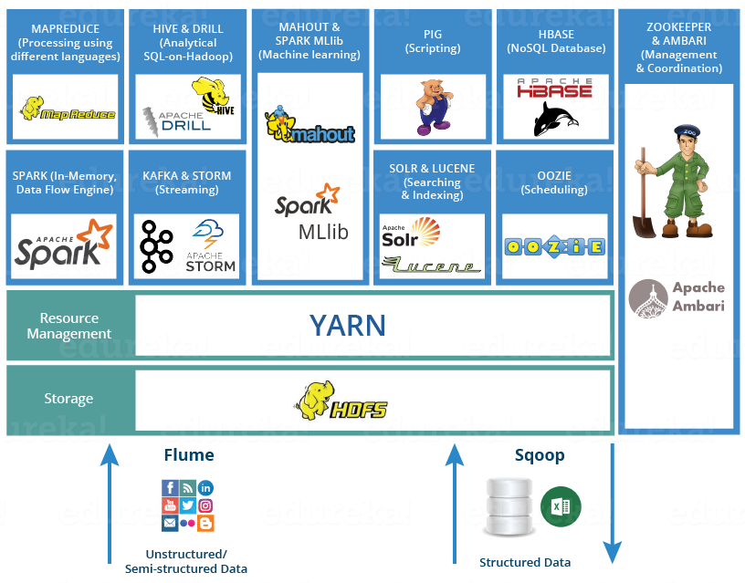
Hadoop Ecosystem

Slide 57
14
Hands-On

Slide 58
Hadoop Installation Steps
Install Hadoop
Step 1: Click here to download the Java 8 Package. Save this file in your home directory.
Step 2: Extract the Java Tar File.
Command: tar -xvf jdk-8u101-linux-i586.tar.gz
Step 3: Download the Hadoop 2.7.3 Package.
Command: wget https://archive.apache.org/dist/hadoop/core/hadoop-2.7.3/hadoop-2.7.3.tar.gz
Step 4: Extract the Hadoop tar File.
Command: tar -xvf hadoop-2.7.3.tar.gz
Step 5: Add the Hadoop and Java paths in the bash file (.bashrc).
Open. bashrc file. Now, add Hadoop and Java Path as shown below.
Command: vi .bashrc
Then, save the bash file and close it.
For applying all these changes to the current Terminal, execute the source command.
Command: source .bashrc
To make sure that Java and Hadoop have been properly installed on your system and can be accessed through the Terminal, execute the java -version and hadoop version commands.
Command: java -version
Command: hadoop version
tep 6: Edit the Hadoop Configuration files.
Command: cd hadoop-2.7.3/etc/hadoop/
Command: ls
All the Hadoop configuration files are located in hadoop-2.7.3/etc/hadoop directory as you can see in the snapshot below:
Step 7: Open core-site.xml and edit the property mentioned below inside configuration tag:
core-site.xml informs Hadoop daemon where NameNode runs in the cluster. It contains configuration settings of Hadoop core such as I/O settings that are common to HDFS & MapReduce.
Command: vi core-site.xml
Editing Core-site - Install Hadoop - Edureka
Property of core-site - Install Hadoop - Edureka

Slide 59
Hadoop Installation Steps
To make sure that Java and Hadoop have been properly installed on your system and can be accessed through the Terminal, execute the java -version and hadoop version commands.
Command: java -version
Command: hadoop version
tep 6: Edit the Hadoop Configuration files.
Command: cd hadoop-2.7.3/etc/hadoop/
Command: ls
All the Hadoop configuration files are located in hadoop-2.7.3/etc/hadoop directory as you can see in the snapshot below:
Step 7: Open core-site.xml and edit the property mentioned below inside configuration tag:
core-site.xml informs Hadoop daemon where NameNode runs in the cluster. It contains configuration settings of Hadoop core such as I/O settings that are common to HDFS & MapReduce.
Command: vi core-site.xml
Editing Core-site - Install Hadoop - Edureka
Property of core-site - Install Hadoop - Edureka

Slide 60
Hadoop Installation Steps
Step 8: Edit hdfs-site.xml and edit the property mentioned below inside configuration tag:
hdfs-site.xml contains configuration settings of HDFS daemons (i.e. NameNode, DataNode, Secondary NameNode). It also includes the replication factor and block size of HDFS.
Command: vi hdfs-site.xml
Step 9: Edit the mapred-site.xml file and edit the property mentioned below inside configuration tag:
mapred-site.xml contains configuration settings of MapReduce application like number of JVM that can run in parallel, the size of the mapper and the reducer process, CPU cores available for a process, etc.
In some cases, mapred-site.xml file is not available. So, we have to create the mapred-site.xml file using mapred-site.xml template.
Command: cp mapred-site.xml.template mapred-site.xml
Command: vi mapred-site.xml.
Step 10: Edit yarn-site.xml and edit the property mentioned below inside configuration tag:
yarn-site.xml contains configuration settings of ResourceManager and NodeManager like application memory management size, the operation needed on program & algorithm, etc.
Command: vi yarn-site.xml

Slide 61
Hadoop Installation Steps
Formatting Name node
After finishing the configuration, let’s try to format the name node using the following command:
hdfs namenode -format
Starting Hadoop services
Now, we will open PowerShell, and navigate to “%HADOOP_HOME%\sbin” directory. Then we will run the following command to start the Hadoop nodes:
.\start-dfs.cmd
Next, we must start the Hadoop Yarn service using the following command:
./start-yarn.cmd
To make sure that all services started successfully, we can run the following command:
jps
Hadoop Web UI
There are three web user interfaces to be used:
Name node web page: http://localhost:9870/dfshealth.html
Data node web page: http://localhost:9864/datanode.html
Yarn web page: http://localhost:8088/cluster

Slide 62

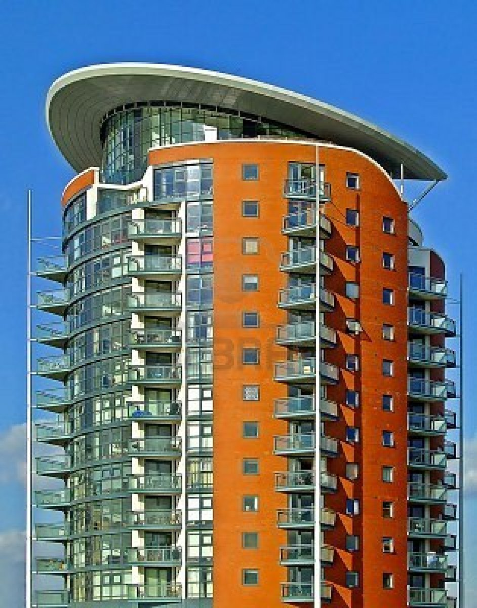
Multitenancy – What is it?
Notes:
RL 7.2
http://www.rightscale.com/blog/enterprise-cloud-strategies/four-steps-achieving-high-availability-cloud

Slide 63
Pros and Cons
 | House | Apartment
Effective use of land | - | +
Privacy | + | -
Infrastructure sharing | - | +
Maintenance cost sharing | - | +
Freedom | + | -
House: Privacy and freedom
Apartment: Cost efficiency
Notes:
http://www.rightscale.com/blog/enterprise-cloud-strategies/four-steps-achieving-high-availability-cloud

Slide 64
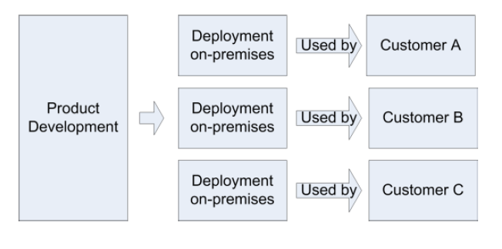
Traditional Deployment Model
Notes:
http://www.rightscale.com/blog/enterprise-cloud-strategies/four-steps-achieving-high-availability-cloud

Slide 65
Multitenancy – Introduction
Multi-tenancy is an architecture in which a single instance of a software application serves multiple customers. Each customer is called a tenant. Tenants may be given the ability to customize some parts of the application, such as color of the user interface (UI) or business rules, but they cannot customize the application's code.
A software-as-a-service (SaaS) provider, for example, can run one instance of its application on one instance of a database and provide web access to multiple customers. In such a scenario, each tenant's data is isolated and remains invisible to other tenants.
Notes:
http://www.rightscale.com/blog/enterprise-cloud-strategies/four-steps-achieving-high-availability-cloud

Slide 66
Multitenancy – Introduction
Multi-tenancy is an architectural pattern
A single instance of the software is run on the service provider’s infrastructure
Multiple tenants access the same instance.
In contrast to the multi-user model, multi-tenancy requires customizing the single instance according to the multi-faceted requirements of many tenants.

Slide 67
Multitenancy – key aspects
A Multi-tenants application lets customers (tenants) share the same hardware resources, by offering them one shared application and database instance ,while allowing them to configure the application to fit there needs as if it runs on dedicated environment.
These definition focus on what we believe to be the key aspects of multi tenancy:
The ability of the application to share hardware resources.
The offering of a high degree of configurability of the software.
The architectural approach in which the tenants make use of a single application and database instance.

Slide 68
Multi-tenants Deployment Modes for Application Server
Fully isolated Application server Each tenant accesses an application server running on a dedicated servers.
Virtualized Application Server Each tenant accesses a dedicated application running on a separate virtual machine.
Shared Virtual Server Each tenant accesses a dedicated application server running on a shared virtual machine.
Shared Application Server The tenant shared the application server and access application resources through separate session or threads.
Application Server
Tenant A
Tenant B
Application server
Application server
Virtual machine
Tenant A
Virtual machine
Tenant B
Application server
Tenant A
Virtual machine
Tenant B
Session thread
Tenant A
Application Server
Tenant B
Session Thread

Slide 69
Multi-tenants Deployment Modes in Data Centers
Fully isolated data center The tenants do not share any data center resources
Virtualized servers The tenants share the same host but access different databases running on separate virtual machines
Shared Server The tenants share the same server (Hostname or IP) but access different databases
Shared Database The tenants share the same server and database (shared or different ports) but access different schema(tables)
Shared Schema The tenants share the same server, database and schema (tables). The irrespective data is segregated by key and rows.
Tenant A
Tenant B
Virtual
Machine
Database
Tenant A
Virtual
Machine
Database
Tenant B
Tenant A
Tenant B
Tenant A
Tenant B
Tenant A
Tenant B

Slide 70
Conceptual framework of Software as a Service
Presentation
Menu and Navigation
User Controls
Display and Rendering
Reporting
Security
Application Engine
Operation
Identity and federation
Monitoring and Altering
User Profile
Workflow
Authentication and Single Sign on
Notification and Subscription
Execution Handling
Backup and Restore
Authorization and Role-based Access Control
Metadata Execution Engine
Orchestration
Provisioning
Configuration and Customization
Entitlement
Metadata Services
Performance and Availability
Encryption
Data Synchronization
Messaging
Metering and Indicators
Regularity Controls
Infrastructure
Database
Storage
Computer
Networking and Communications
Notes:
Architectural Overview Of Cloud Computing
B.M. Rao, Senior Technical Director
National Informatics Centre,
Hyderaad

Slide 71
Thank you

Slide 72
Introduction to cloud security
If cloud computing is so great, why isn’t everyone doing it?
The cloud acts as a big black box, nothing inside the cloud is visible to the clients
Clients have no idea or control over what happens inside a cloud
Even if the cloud provider is honest, it can have malicious system admins who can tamper with the VMs and violate confidentiality and integrity
Clouds are still subject to traditional data confidentiality, integrity, availability, and privacy issues, plus some additional attacks
Notes:
RL 7.3

Slide 73
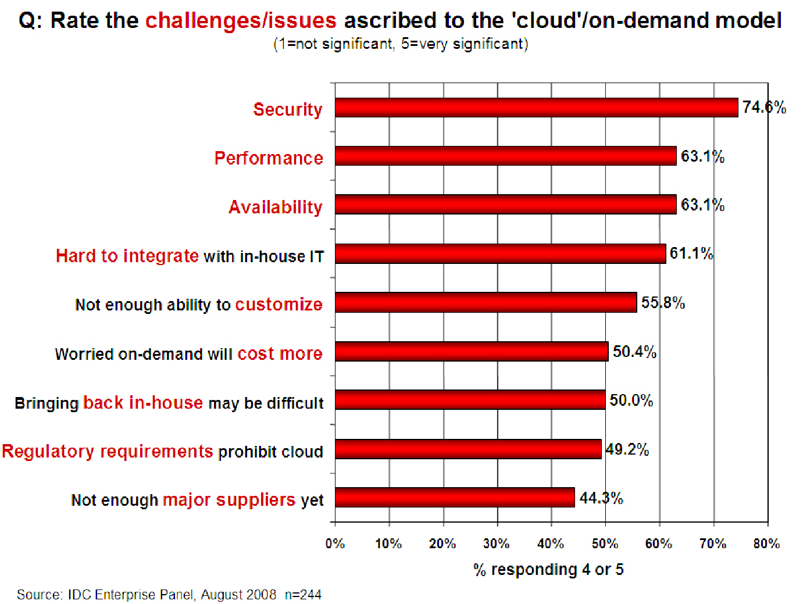
Companies are still afraid to use clouds

Slide 74
Cloud Security Issues
Most security problems stem from:
Loss of Control
Take back control
Data and apps may still need to be on the cloud
But can they be managed in some way by the consumer?
Lack of trust
Increase trust (mechanisms)
Technology
Policy, regulation
Contracts (incentives): topic of a future talk
Multi-tenancy
Private cloud
Takes away the reasons to use a cloud in the first place
VPC: its still not a separate system
Strong separation
These problems exist mainly in 3rd party management models
Self-managed clouds still have security issues, but not related to above

Slide 75
Loss of Control in the Cloud
Consumer’s loss of control
Data, applications, resources are located with provider
User identity management is handled by the cloud
User access control rules, security policies and enforcement are managed by the cloud provider
Consumer relies on provider to ensure
Data security and privacy
Resource availability
Monitoring and repairing of services/resources

Slide 76
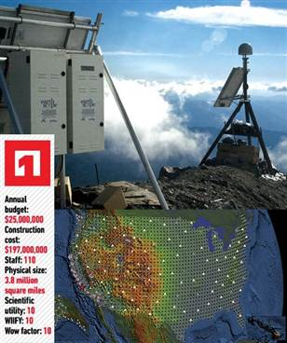
1.
The Earthscope
The Earthscope is the world's largest science project. Designed to track North America's geological evolution, this observatory records data over 3.8 million square miles, amassing 67 terabytes of data. It analyzes seismic slips in the San Andreas fault, sure, but also the plume of magma underneath Yellowstone and much, much more. (http://www.msnbc.msn.com/id/44363598/ns/technology_and_science-future_of_technology/#.TmetOdQ--uI)

Slide 77
Multi-tenancy Issues in the Cloud
Conflict between tenants’ opposing goals
Tenants share a pool of resources and have opposing goals
How does multi-tenancy deal with conflict of interest?
Can tenants get along together and ‘play nicely’ ?
If they can’t, can we isolate them?
How to provide separation between tenants?
Cloud Computing brings new threats
Multiple independent users share the same physical infrastructure
Thus an attacker can legitimately be in the same physical machine as the target

Slide 78
Taxonomy of Fear
Confidentiality
Fear of loss of control over data
Will the sensitive data stored on a cloud remain confidential?
Will cloud compromises leak confidential client data
Will the cloud provider itself be honest and won’t peek into the data?
Integrity
How do I know that the cloud provider is doing the computations correctly?
How do I ensure that the cloud provider really stored my data without tampering with it?

Slide 79
Taxonomy of Fear
Availability
Will critical systems go down at the client, if the provider is attacked in a Denial of Service attack?
What happens if cloud provider goes out of business?
Would cloud scale well-enough?
Often-voiced concern
Although cloud providers argue their downtime compares well with cloud user’s own data centers

Slide 80
Taxonomy of Fear
Privacy issues raised via massive data mining
Cloud now stores data from a lot of clients, and can run data mining algorithms to get large amounts of information on clients
Increased attack surface
Entity outside the organization now stores and computes data, and so
Attackers can now target the communication link between cloud provider and client
Cloud provider employees can be phished

Slide 81
Taxonomy of Fear
Audit-ability and forensics (out of control of data)
Difficult to audit data held outside organisation in a cloud
Forensics also made difficult since now clients don’t maintain data locally
Legal quagmire and transitive trust issues
Who is responsible for complying with regulations?
e.g., SOX, HIPAA, GLBA ?
If cloud provider subcontracts to third party clouds, will the data still be secure?

Slide 82
Threat Model
A threat model helps in analysing a security problem, design mitigation strategies, and evaluate solutions
Steps:
Identify attackers, assets, threats and other components
Rank the threats
Choose mitigation strategies
Build solutions based on the strategies

Slide 83
Threat Model
Basic components
Attacker modelling
Choose what attacker to consider
insider vs. outsider?
single vs. collaborator?
Attacker motivation and capabilities
Attacker goals
Vulnerabilities / threats

Slide 84
Cloud Fair Queuing
The algorithm ensures that a high-data-rate flow cannot use more than its fair share of the link capacity. Packets are first classified into flows by the system and then assigned to a queue dedicated to the flow. Packet queues are serviced one packet at a time in round-robin (RR) order.
Interconnection networks allow cloud servers to communicate with one another and with users. These networks consist of communication links of limited bandwidth and switches/routers/gateways of limited capacity. When the load exceeds its capacity, a switch starts dropping packets because it has limited input buffers for the switching fabric and for the outgoing links, as well as limited CPU cycles.
a scheduling algorithm has to manage several quantities at the same time: the bandwidth, the amount of data each flow is allowed to transport; the timing when the packets of individual flows are transmitted; and the buffer space allocated to each flow.
A first strategy to avoid network congestion is to use a FCFS scheduling algorithm. The advantage of the FCFS algorithm is a simple management of the three quantities: bandwidth, timing, and buffer space. Nevertheless, the FCFS algorithm does not guarantee fairness; greedy flow sources can transmit at a higher rate and benefit from a larger share of the bandwidth.
To address this problem, a fair queuing algorithm proposed in requires that separate queues, one per flow, be maintained by a switch and that the queues be serviced in a round-robin manner. This algorithm guarantees the fairness of buffer space management, but does not guarantee fairness of bandwidth allocation. Indeed, a flow transporting large packets will benefit from a larger bandwidth

Slide 85
QoS
Quality of service (QoS) is the description or measurement of the overall performance of a service, such as a telephony or computer network, or a cloud computing service, particularly the performance seen by the users of the network.
System supports three types of QoS: application QoS, IP QoS and role QoS. ... Introduction to QoS
Application QoS: Controls the bandwidth used by applications.
IP QoS: Controls the bandwidth of designated IP addresses.
Role QoS: Also called role-based QoS. It controls the bandwidth of designated roles.

Slide 86
Thank you

Slide 87
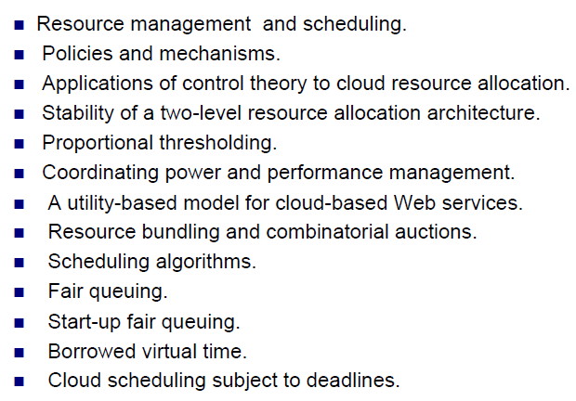
Content

Slide 88
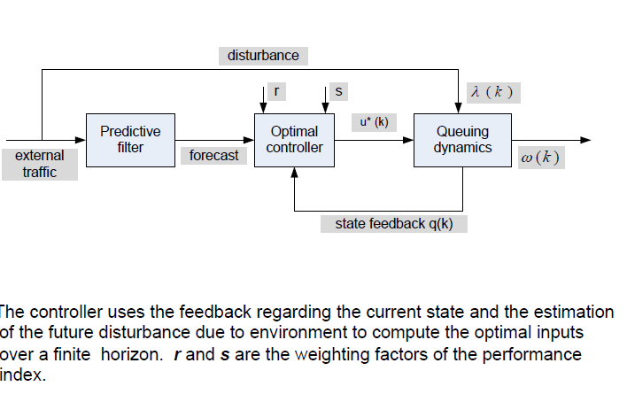
Cloud Control Structure

Slide 89
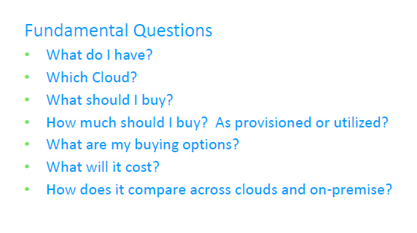
Cloud Planning

Slide 90
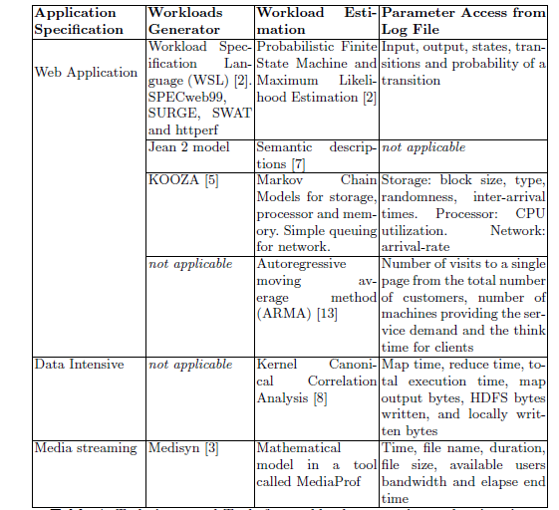
Work Load
Different cloud platforms offer similar services with different characteristics, names, and functionalities. Therefore, describing cloud platform entities in such a way that they can be mapped to each other is critical to enable a smooth migration across platforms. DSL that uses a common cloud vocabulary for describing cloud entities covering a wide variety of cloud IaaS services.

Slide 91
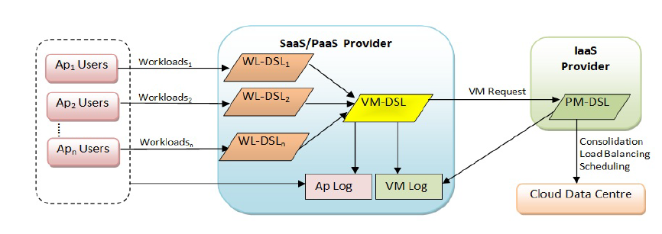
Work Load Capacity Management Framework

Slide 92
Why do we use HDFS for applications having large data sets and not when there are a lot of small files?
HDFS is more suitable for large amounts of data sets in a single file as compared to small amount of data spread across multiple files. As you know, the NameNode stores the metadata information regarding the file system in the RAM. Therefore, the amount of memory produces a limit to the number of files in my HDFS file system. In other words, too many files will lead to the generation of too much metadata. And, storing these metadata in the RAM will become a challenge. As a thumb rule, metadata for a file, block or directory takes 150 bytes.

Slide 93
How do you define “Rack Awareness” in Hadoop?
Rack Awareness is the algorithm in which the “NameNode” decides how blocks and their replicas are placed, based on rack definitions to minimize network traffic between “DataNodes” within the same rack. Let’s say we consider replication factor 3 (default), the policy is that “for every block of data, two copies will exist in one rack, third copy in a different rack”. This rule is known as the “Replica Placement Policy”.
What is the difference between an “HDFS Block” and an “Input Split”?
The “HDFS Block” is the physical division of the data while “Input Split” is the logical division of the data. HDFS divides data in blocks for storing the blocks together, whereas for processing, MapReduce divides the data into the input split and assign it to mapper function.

Slide 94
state the reason why we can’t perform “aggregation” (addition) in mapper? Why do we need the “reducer” for this?
This answer includes many points, so we will go through them sequentially.
We cannot perform “aggregation” (addition) in mapper because sorting does not occur in the “mapper” function. Sorting occurs only on the reducer side and without sorting aggregation cannot be done.
During “aggregation”, we need the output of all the mapper functions which may not be possible to collect in the map phase as mappers may be running on the different machine where the data blocks are stored.
And lastly, if we try to aggregate data at mapper, it requires communication between all mapper functions which may be running on different machines. So, it will consume high network bandwidth and can cause network bottlenecking.

Slide 95
How do “reducers” communicate with each other?
This is a tricky question. The “MapReduce” programming model does not allow “reducers” to communicate with each other. “Reducers” run in isolation.
What does a “MapReduce Partitioner” do?
A “MapReduce Partitioner” makes sure that all the values of a single key go to the same “reducer”, thus allowing even distribution of the map output over the “reducers”. It redirects the “mapper” output to the “reducer” by determining which “reducer” is responsible for the particular key.

Slide 96
What is Apache HBase?
HBase is an open source, multidimensional, distributed, scalable and a NoSQL database written in Java. HBase runs on top of HDFS (Hadoop Distributed File System) and provides BigTable (Google) like capabilities to Hadoop. It is designed to provide a fault-tolerant way of storing the large collection of sparse data sets. HBase achieves high throughput and low latency by providing faster Read/Write Access on huge datasets.

Slide 97
What are the different types of file formats used to store in the Apache Hadoop?
CSV, JSON, Columnar, Sequence files, AVRO and Parquet file are some of the files used in Apache Hadoop.
Cloumnar-he columnar data formats are a popular choice for fast analytics workloads. As opposed to row-oriented storage, columnar storage can significantly reduce the amount of data fetched from disk by allowing access to only the columns that are relevant for the particular query or workload.
Avro-Avro format is a row-based storage format for Hadoop, which is widely used as a serialization platform. Avro format stores the schema in JSON format, making it easy to read and interpret by any program. The data itself is stored in a binary format making it compact and efficient in Avro files

Slide 98
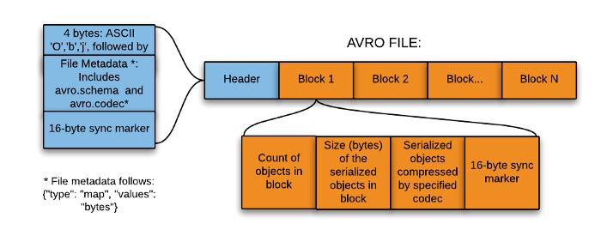

Slide 99
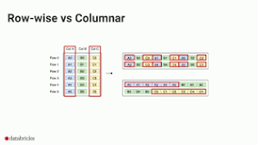
Apache Parquet is an open source, column-oriented data file format designed for efficient data storage and retrieval. It provides efficient data compression and encoding schemes with enhanced performance to handle complex data in bulk.

Slide 100
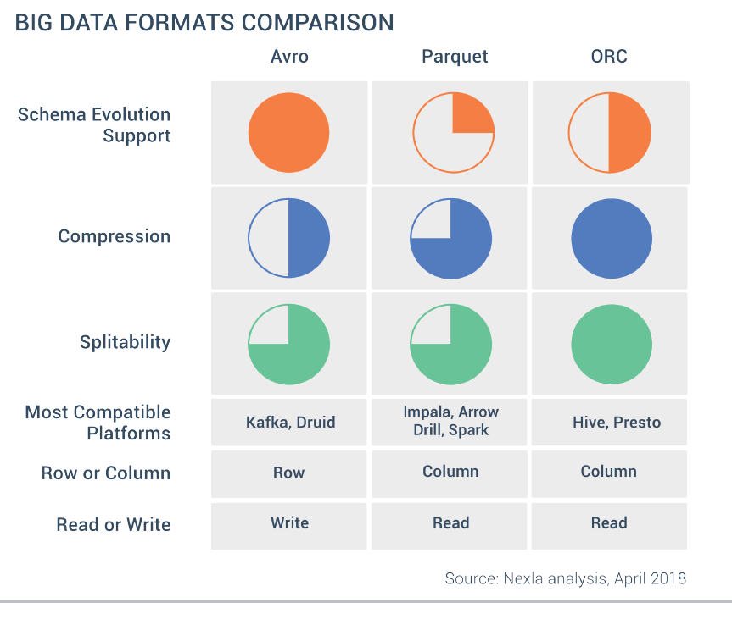

Slide 101
